Slide 1
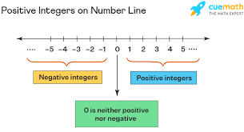
JAVA TUTORIAL
JAVA LEARN

Slide 2
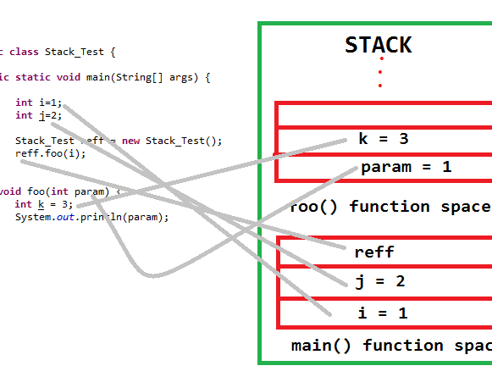
ARRAY
2D ARRAY
1D ARRAY
ARRAYLIST
NEXT

